Slide 1
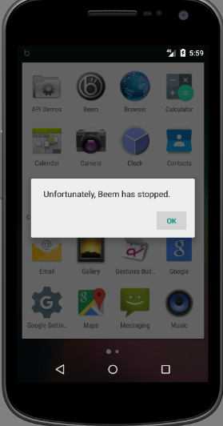

Repairing crashes in Android Apps 安卓应用的程序崩溃修复
Shin Hwei Tan* | Zhen Dong^ | Xiang Gao^ | Abhik Roychoudhury^
Southern University of Science and Technology* National University of Singapore^

Slide 2
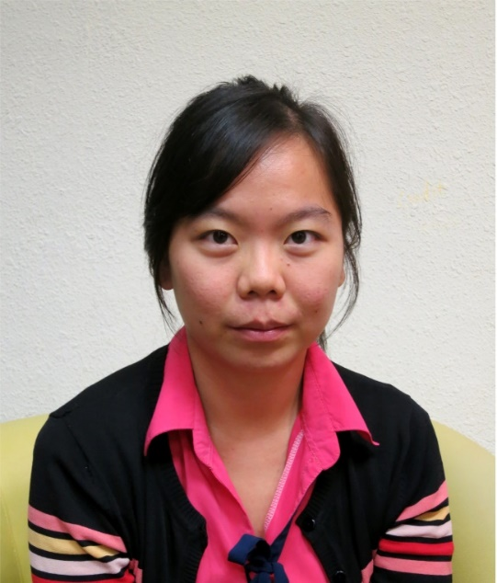



Shin Hwei Tan 陈馨慧
Website: https://www.shinhwei.com/
Email: tansh3@sustc.edu.cn
程序自动修复
测试用例修复
代码注释分析
软件测试
基于搜索的软件工程
伊利诺伊大学厄巴纳-香槟分校硕士
伊利诺伊大学厄巴纳-香槟分校学士
UIUC
新加坡国立大学博士
南方科技大学助理教授

Slide 3
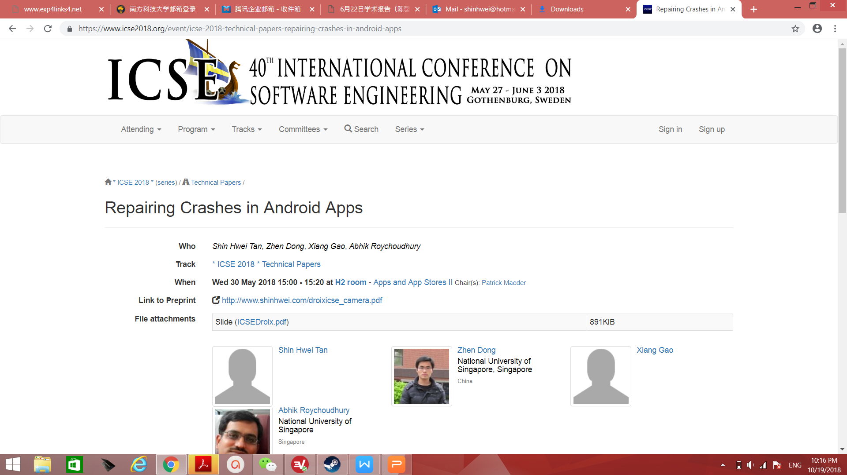
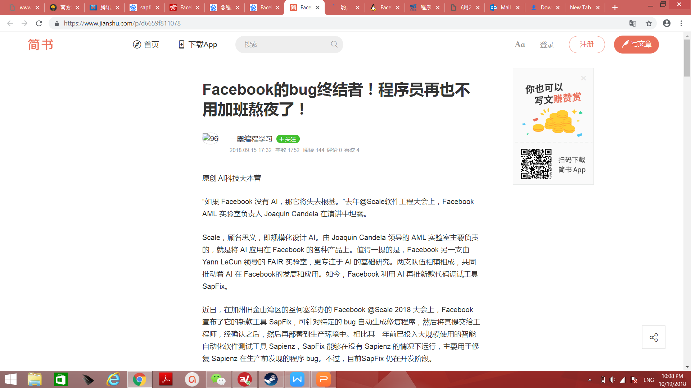
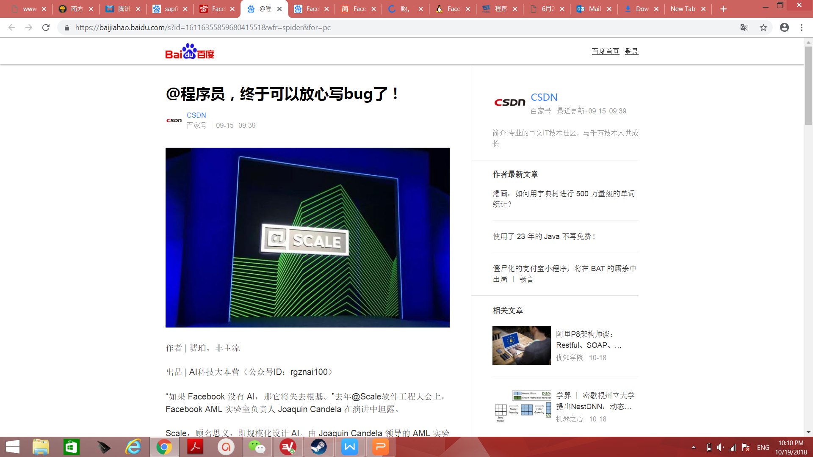
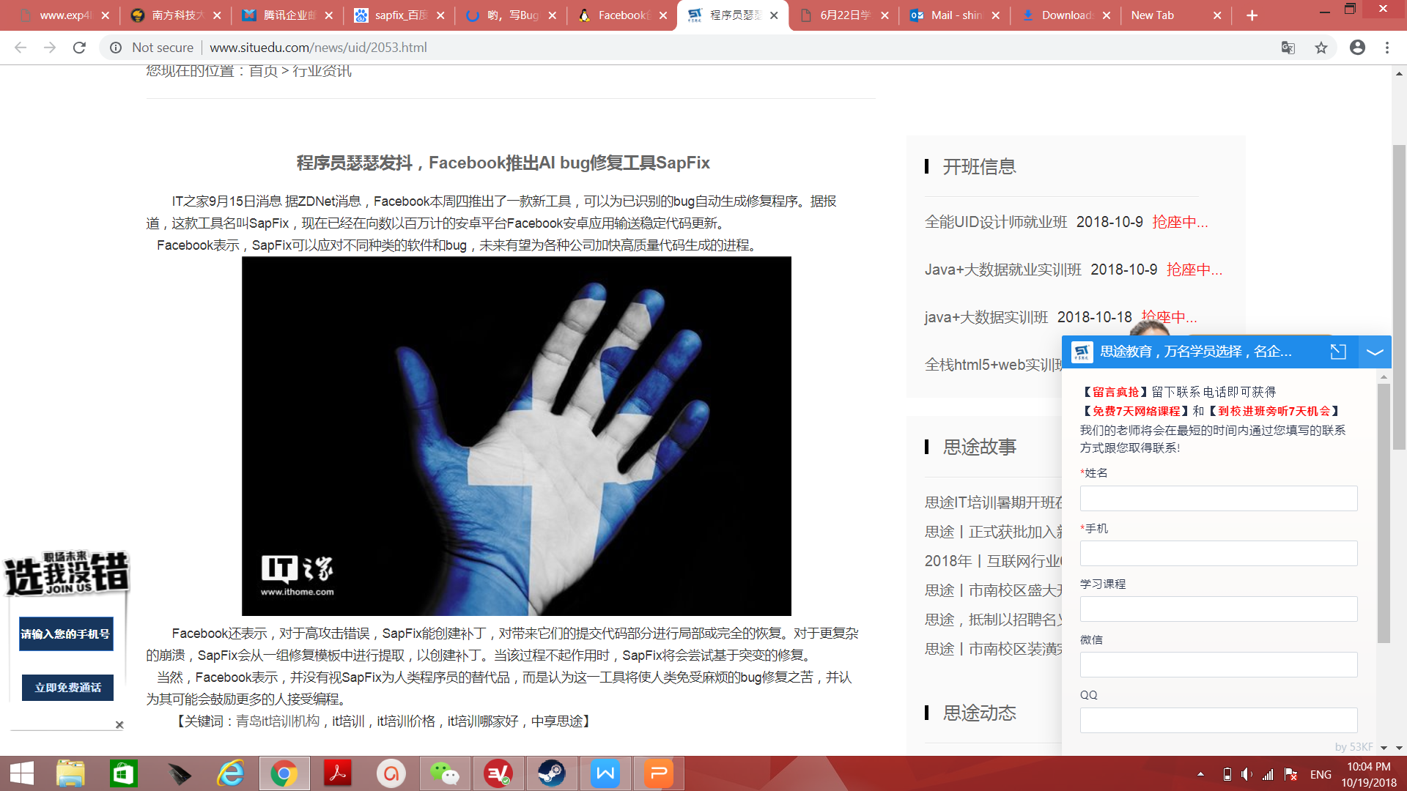

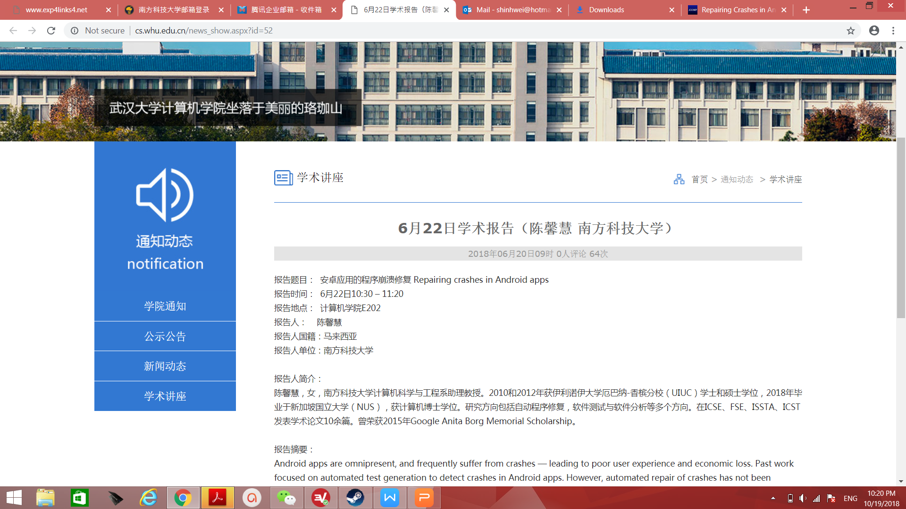

Slide 4
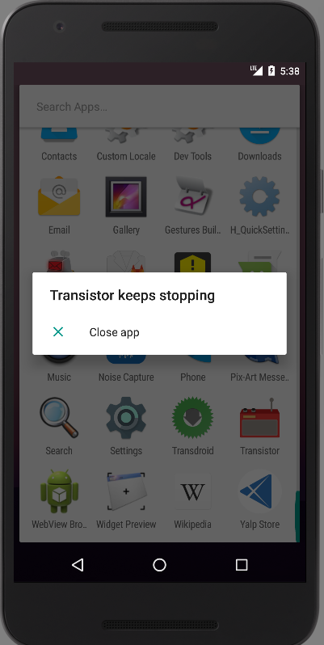
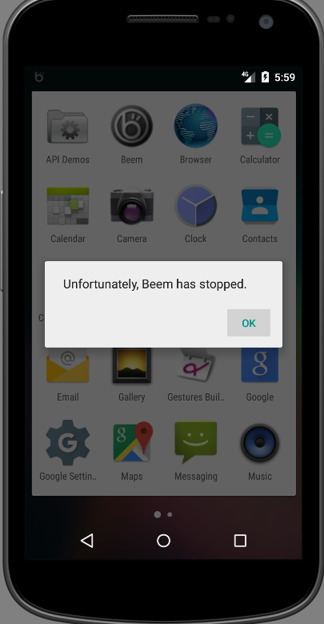

Android Repair System
Criteria for Android repair system:
Could be used by any smartphone user
Doesn’t require source code
No prior knowledge of Android app
No prior experience of running tests

Slide 5
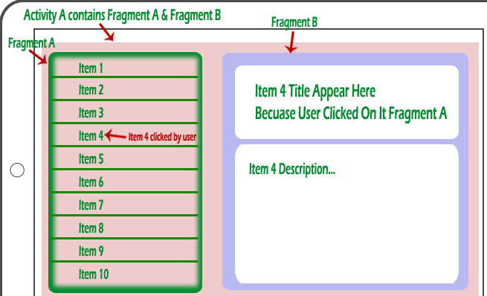
Background: Activity/Fragment
Item 4 Title Appear Here
Because User Click On Fragment A
Notes:
Each fragment can be modified independently of the host activity
(activity containing the fragment) by performing a set of changes

Slide 6
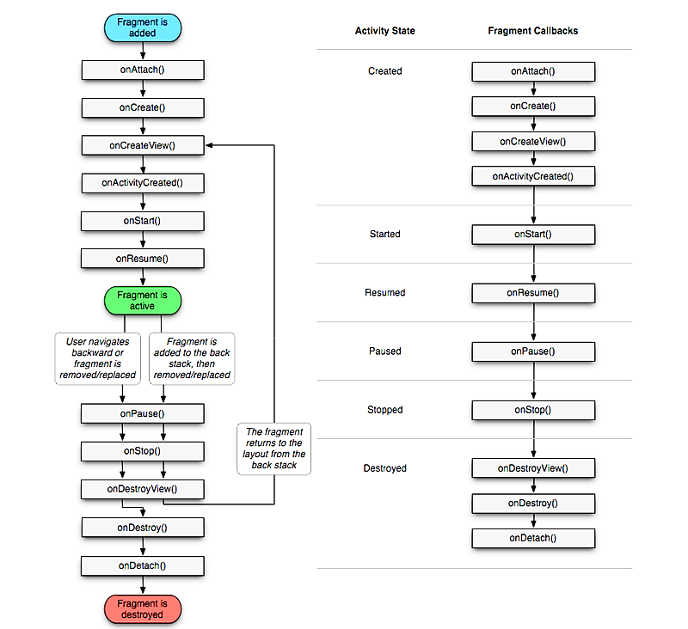
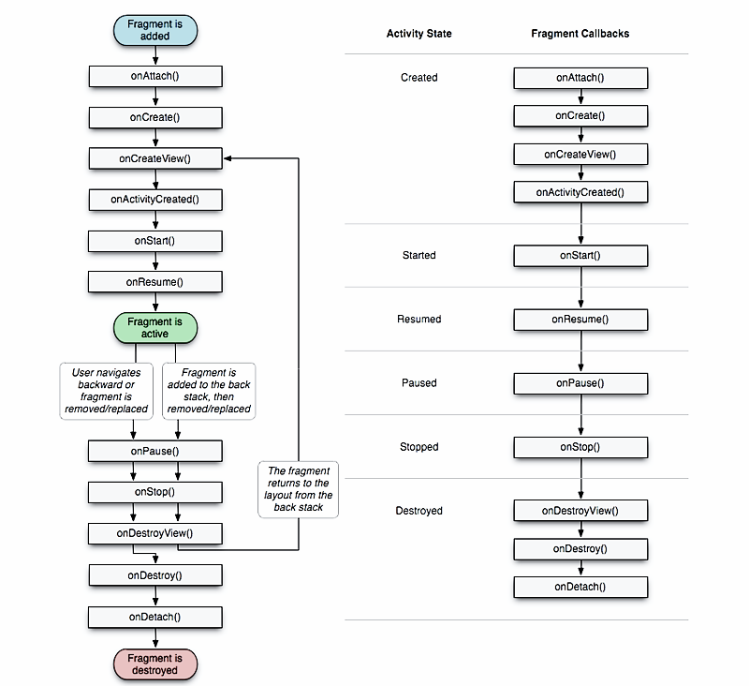
Complexity of Android Activity/Fragment Lifecycle
Activity State
Fragment Callbacks
Created
Started
Resumed
Paused
Stopped
Destroyed
Notes:
Each method represents a lifecycle callback, a method that gets called given a change of state. Lifecycle transition obeys certain principles. For
instance, an activity with the paused state could move to the resumed state or
the stopped state, or may be killed by the Android system to free up RAM.
A fragment is a portion of user interface or a behavior that can be put in
an Activity. Each fragment can be modified independently of the host activity
(activity containing the fragment) by performing a set of changes. For a fragment,
it goes through more states than an Activity from being launched to the active

Slide 7

What are the common causes of crashes in Android apps?
Obtain popular Android apps written in Java
from
For each app, search for closed bug reports
>7500 bug reports
Filter crash-related bug reports
1155 bug reports
15% of bug reports in Android apps are crash-related
Filter bug reports with bug-fixing commits
107 GitHub Issues from 15 apps

Slide 8
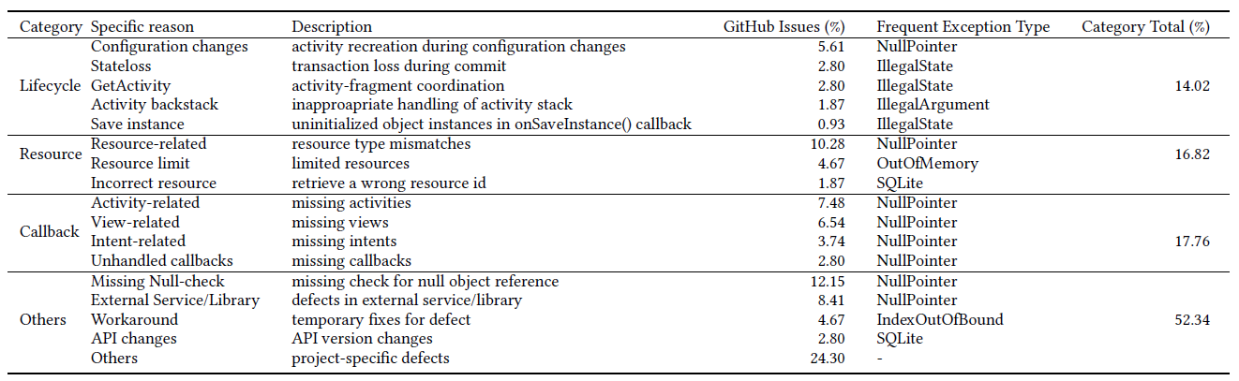
What lead to crashes in Android apps?
Common root causes of crashes in apps:
Lifecycle-related (14.02%)
Resource-related (16.82%)
Workaround: 4.67 %
Most common exceptions
NullPointerException (40.19%)
IllegalStateException (7.48%)
Could be automatically repaired

Slide 9
Lifecycle-aware Repair Operators
Operator | Description
S1: GetActivity-check | Insert a condition to check whether the activity containing the fragment has been created.
S2: Retain object | Store object and load it when configuration changes
S3: Replace resource id | Replace resource id with another id of same type.
S4: Replace method | Replace the current method call with another method call with similar name and compatible parameter types.
S5: Replace cast | Replace the current type cast with another compatible type.
S6: Move stmt | Removes a statement and add it to another location.
S7: Null-check | Insert condition to check if a given object is null.
S8: Try-catch | Insert try-catch blocks for the given exception.

Slide 10
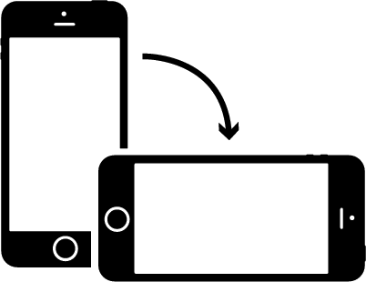
Lifecycle-aware Repair Operator: Retain stateful object
Activity re-created:
onDestroy()→onCreate()
public void onCreate(Bundle savedInstanceState) {…
+ setRetainInstance(true);// retain this fragment
}
// new field for saving the object
+ private static Option saveOption;
public View onCreateView(LayoutInflater inflater,
ViewGroup container, Bundle savedInstanceState) {
// saving and loading the object
+ if(option!=null){
+ saveOption = option;
+ }else{
+ option = saveOption;
+ }
 switch (option.getButtonStyle()){
1
2
3

Slide 11



Android Apps Repair System (Droix)
Droix
Buggy APK
Mutant
Logs
Bug locations
Log analyzer
Mutant generator
Decompiler
Bug report
UI sequence
Test checker
Operators
Violations
Evaluator
Code checker
Violations
Fixed APK
Selector
APKs
Mutants pool

Slide 12
Android Apps Repair System (Droix)
Droix
Buggy APK
Mutant
Logs
Fault locations
Log analyzer
Mutant generator
Decompiler
Bug report
UI sequence
Test checker
Operators
Violations
Evaluator
Code checker
Violations
Fixed APK
Selector
APKs
Mutants pool

Slide 13
Test-Level Properties Checking
Logs
Log analyzer
UI sequence
Test checker
Evaluator
Violations
Record activity transitions in logs during test replay
Given activity transitions current-state→next-state, check for violations to Android activity/fragment lifecycle management rules

Slide 14
Code-level Properties Checking
Log analyzer
Fault
locations
Mutant generator
Violations
Evaluator
Code checker
For each program transformation by the mutant generator, check if it is valid in terms of compilation errors and coding conventions.

Slide 15
Locating the fault
Logs
Log analyzer
Fault
locations
Mutant generator
UI sequence
Test checker
Violations
Evaluator
Code checker
Violations
Do not required source code & heavy test suite
Log analyzer extracts stack trace information:
Exception Type
Lines in code where exception is thrown
Method calls in the stacktrace
Log analyzer extracts callbacks invoked during execution of UI sequence

Slide 16
Code-level & Test-level Properties in Droix
Level | Type | Description
Code-level | Well-formedness | Compilable and structural type of program matches with the context of selected operator.
 | Bug hazard | Transformation violates Java exception-handling best practices.
 | Exception Type | Transformation matches given exception type.
Test-level (Android-specific) | Lifecycle | Event transition matches with the activity/fragment lifecycle model.
 | Activity-Fragment | Interaction between a fragment and its parent activity matches the activity-fragment coordination model
 | Commit | Commit of fragment’s transactions in allowed states.
Bug hazard: “What not to do when handling exception?”
Similar concepts as anti-patterns [FSE’16]

Slide 17
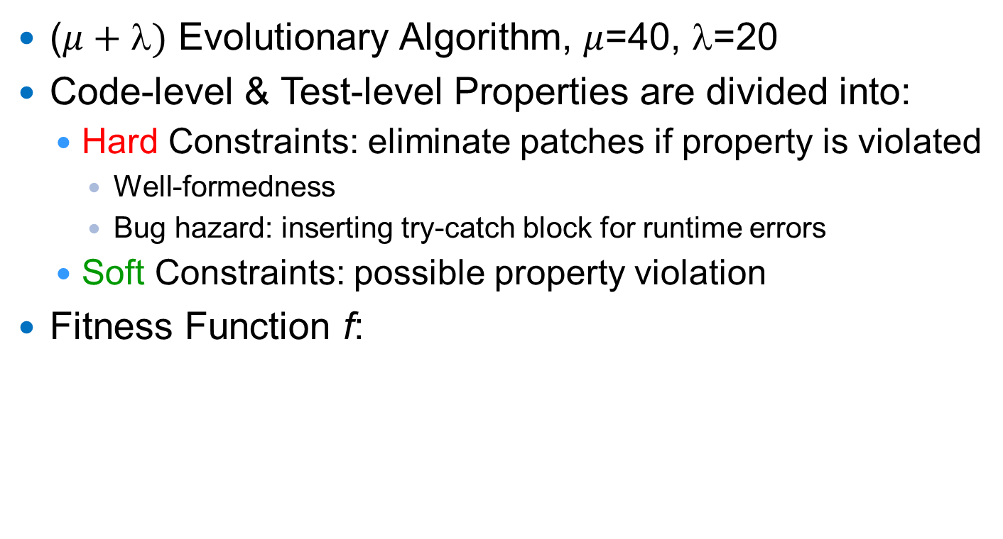
Searching for Patches
($μ+)$ Evolutionary Algorithm, $μ$=40, $$=20
Code-level & Test-level Properties are divided into:
Hard Constraints: eliminate patches if property is violated
Well-formedness
Bug hazard: inserting try-catch block for runtime errors
Soft Constraints: possible property violation
Fitness Function f:
f = Minimize # of violations for soft constraints
Notes:
Error represents an unrecoverable condition which should not be handled

Slide 18
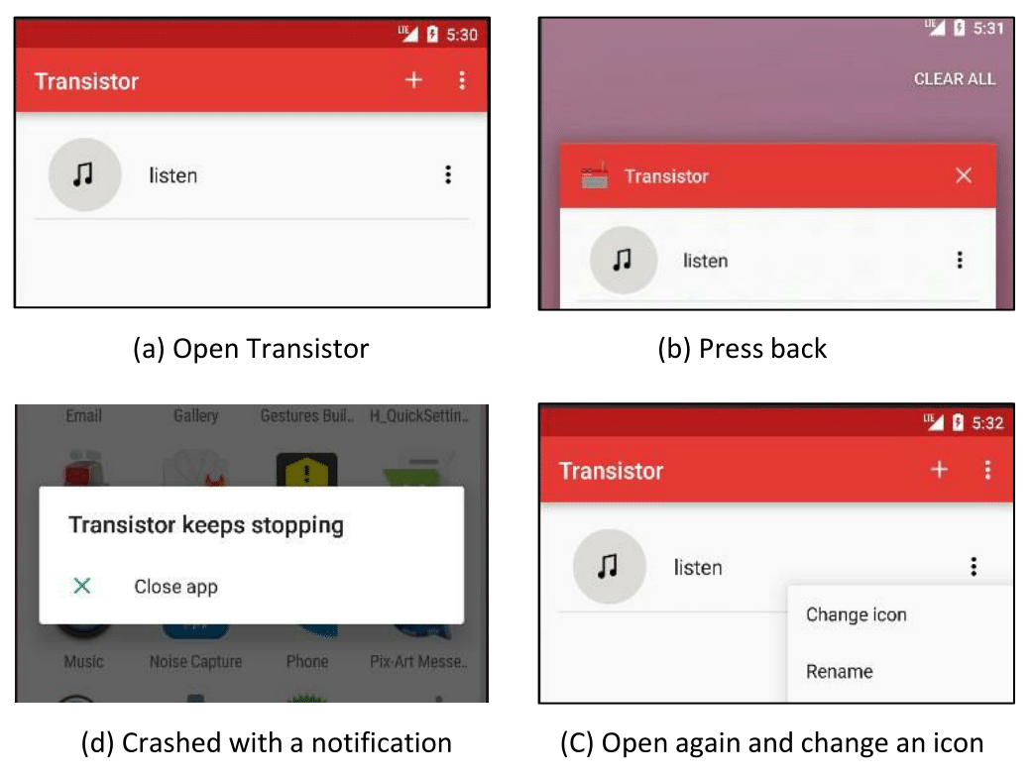
Example: Transistor
FATAL EXCEPTION: MAIN
PROCESS: ORG.Y20K.TRANSISTOR, PID: 2416
JAVA.LANG.ILLEGALSTATEEXCEPTION:
FRAGMENT MAINACTIVITYFRAGMENT{82E1BEC}
NOT ATTACHED TO ACTIVITY
Fragment is detached from the previous activity during app termination & should be attached to new activity in the restarting app.

Slide 19
Example: Transistor
Developer’s patch
- startActivityForResult ( pickImageIntent , REQUEST_LOAD_IMAGE);
+ mActivity.startActivityForResult ( pickImageIntent , REQUEST_LOAD_IMAGE);
Reuse old activity (mActivity)
Droix’s patch
+ if ( getActivity() !=null )
startActivityForResult ( pickImageIntent , REQUEST_LOAD_IMAGE);
Check if activity containing the fragment has been created.
Which patch is better
?

Slide 20
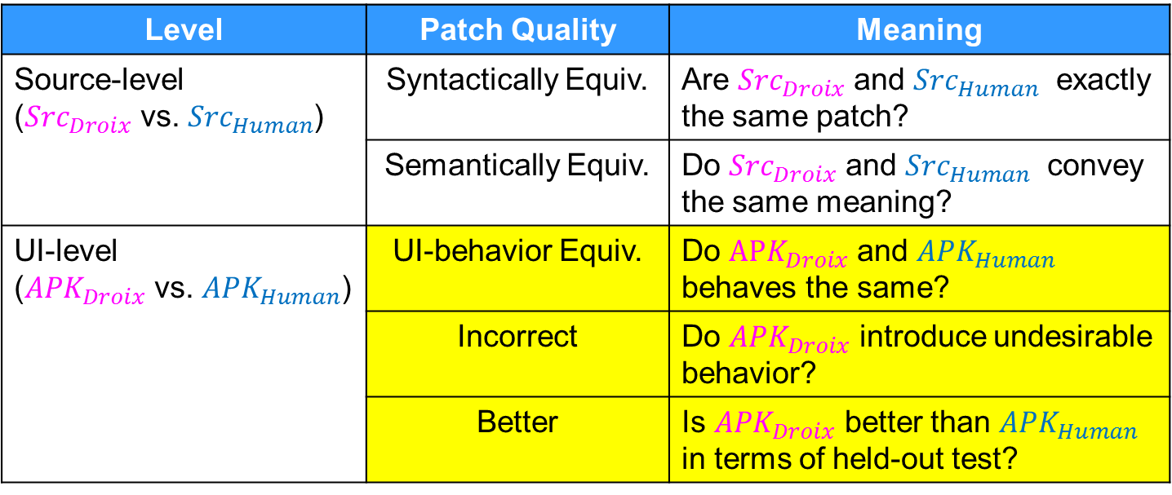
How to compare two patches?
Level | Patch Quality | Meaning
 | Syntactically Equiv.
 | Semantically Equiv.
 | UI-behavior Equiv.
 | Incorrect
 | Better
Newly added classification: allow more detailed comparison at the GUI level

Slide 21

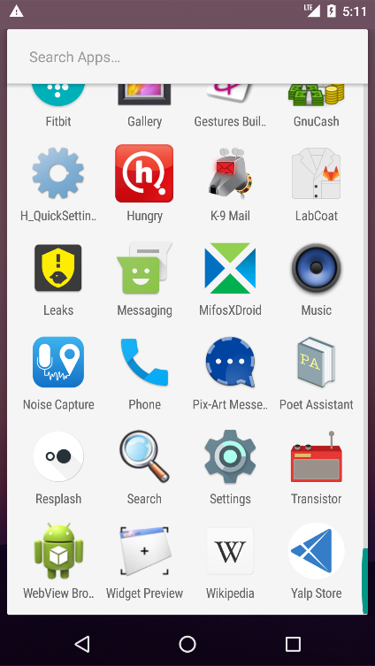
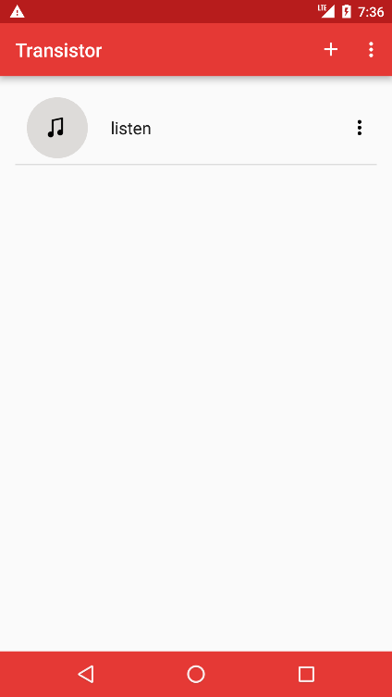
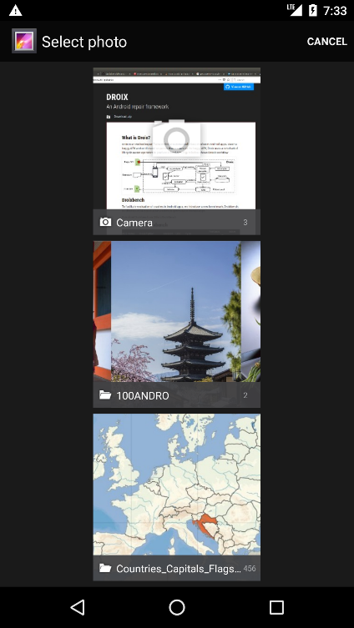


Which patch is better?
Patch generated by Droix
Patch crafted by human
<17minutes to fix
2 days to fix
Resolved 9 months later

Slide 22






Empirical Evaluation of Droix
Benchmark: Droixbench
Evaluation results
Repaired 12 crashes
Comparing with developer’s repair
1 better
7 syntactic equivalent
1 semantic equivalent
3 UI-behavior equivalent
Fdroid
PoetAssistant
K-9 Mail
......
AnkiDroid
ConnectBot
24 crashes in 15 mobile apps

Slide 23
Summary
Android repair system that could repair crashes based on a single UI sequence
Instead of relying on test cases, we use code-level and test-level properties
Propose a set of lifecycle-aware repair operators
Droixbench: benchmark with reproducible crashes in Android apps, extracted from GitHub

